Slide 1
Research Progress of DIC & DLD
Jul 31, 2018
Xingyu Su

Slide 2
iOS Droplet Counter
Build iOS App
Adding frame rate modification
Adding Gaussian Mixture way
Adding selection from camera or gallery
Adding Magnification
Prepare for experiment
Better shape detector
Multi line droplets

Slide 3
iOS Droplet Counter
Notes:
Internal contour and external contour is adjoining in simple channel, but in complex one, their position in contours will vary a lot. So I will matching every circle before confirming it is a new one.
I tried different circle fit algorithm.

Slide 4
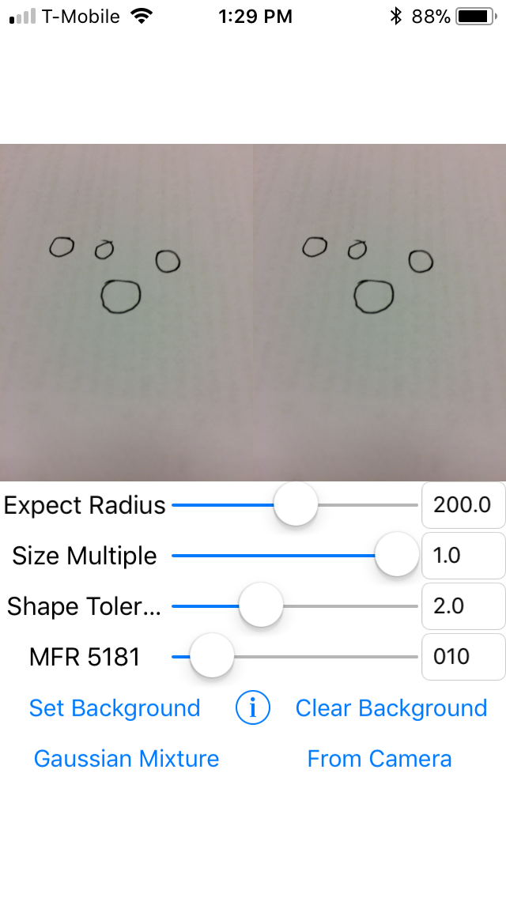
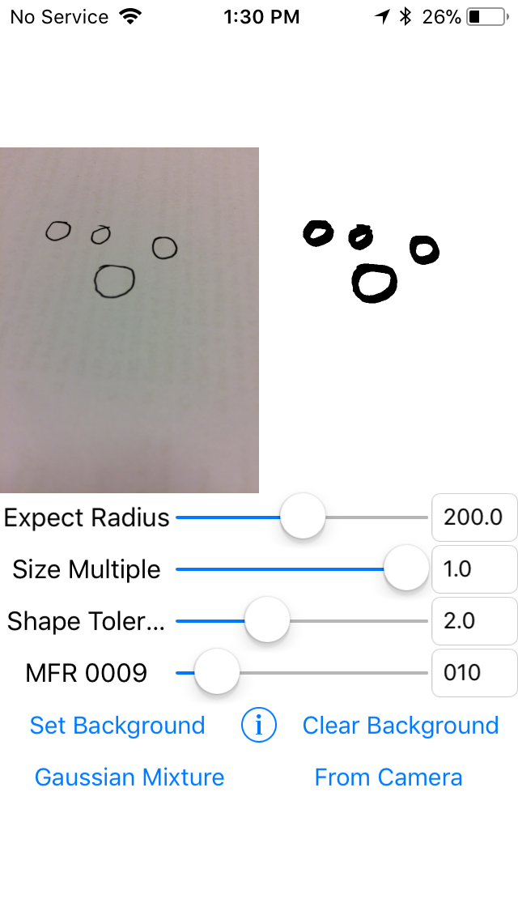
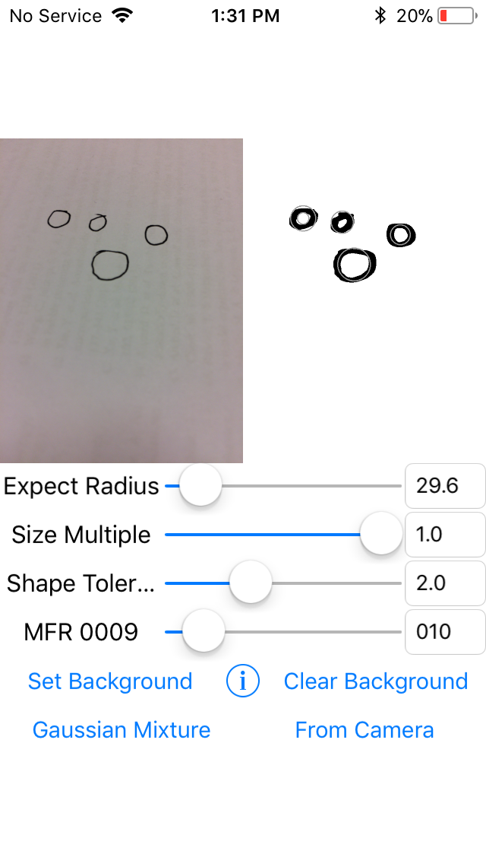
iOS Droplet Counter
Original
(5000+ max frame rate)
With background set
(~10 frame rate)
Adjust to expect radius
(~10 frame rate)
Notes:
Build the App on iPhone:
Adjusting expect radius, size magnification, frame rate, background source, camera orientation.

Slide 5
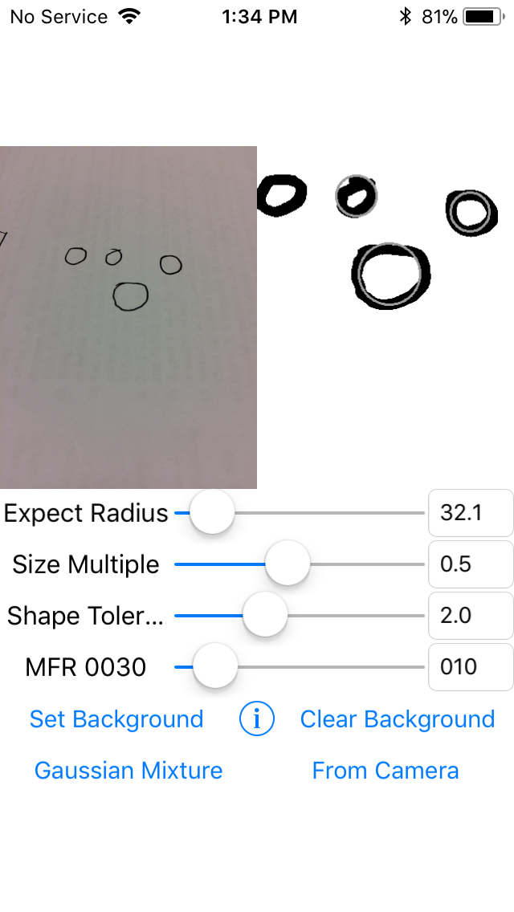
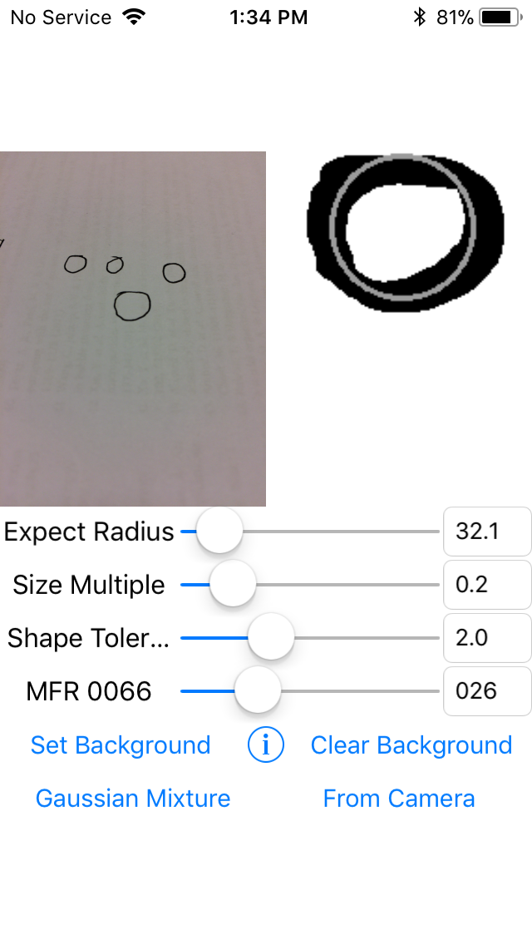
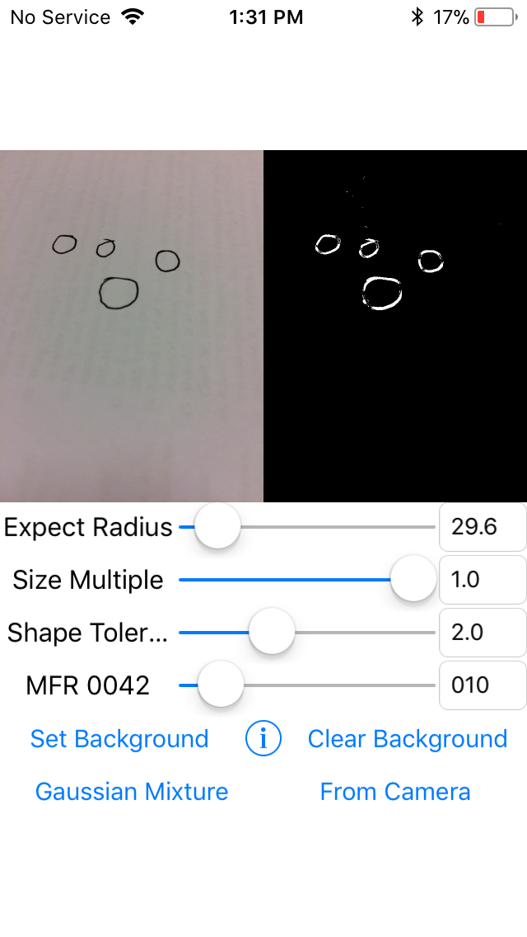
iOS Droplet Counter
Magnify to 0.5w*0.5h
(~30 frame rate)
Magnify to 0.2w*0.2h
(~65 frame rate)
Optional Methods: MOG
(~42 frame rate)

Slide 6
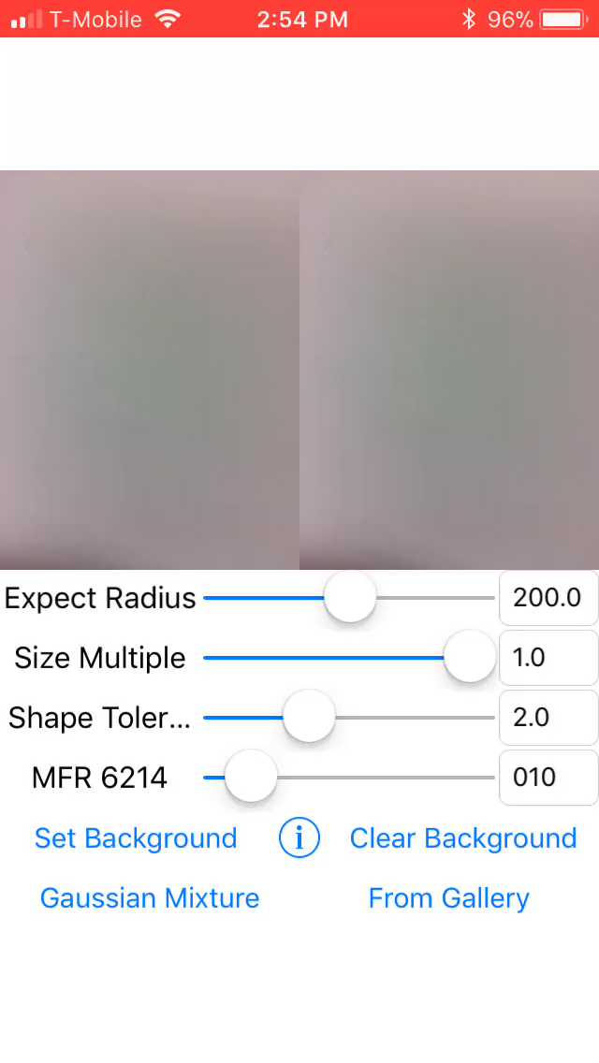

Slide 7
Droplet Length Decoder
Move Python demo to C++
Learn Camera’s SDK and samples
Windows computer setting
Fast Camera SDK
OpenCV environment
Move C++ code to VS project

Slide 8
Droplet Length Decoder
Droplet Length Design
Destination
Encoder 0
Encoder 1
Partition
Droplet queue in channel
Partition first
Encoder 0100
Destination array
Notes:
Camera’s frame is a small window of the whole channel.
My target is to decode length information from a small window.

Slide 9
Droplet Length Decoder
Encoding Length: 4
Decoding Result: 0100
Encoding Length: 6
Decoding Result: 000100
or 001000
Notes:
The upside is a simple condition.
Because a partition first, there couldn’t have partition in following few droplets.
But if we have same sample rate but faster droplet, which means less information of one droplet. It will be difficult to decode.

Slide 10
Droplet Length Decoder
Original Droplets
Detected upside and downside
Template Matching
Notes:
The only information I can get is the length of every droplet by template matching.

Slide 11
Droplet Length Decoder
. . .
. . .
. . .
or
. . .
. . .
X
or
. . .
X
Last Frame
This Frame
Notes:
There is many condition of between last frame and the coming frame.

Slide 12
Droplet Length Decoder
Notes:
And I get the algorithm worked in any condition that window size is bigger than template size.

Slide 13
Overview
iOS Droplet Counter
Moving C++ demo to iOS
Adding frame rate modification
Adding Gaussian Mixture way
Adding selection from camera or gallery
Adding Magnification
Testing different circle fit methods
Droplet Length Decoder
Learning Fast Camera C++ SDK
Moving Python demo to C++
Length detector by C++ & Camera SDK (500 MFR with 128*32pixel image)
Testing Win32 Serial Communication

Slide 14
Next Week Plan
iOS Droplet Counter
Using video
Counting droplets
Wait Geonsoo’s channel for testing
Experiment and Improvement
Droplet Length Decoder
Wait Steven’s video for testing
Calibration
Encoding Format and Real-time Decoding
TTL signal generation by WIN

Slide 15
Thanks
Notes:
Thanks all of you for watching and listening.

